Slide 1
Plan for Interim Election
July 2024
Bo Wernick, Secretary

Slide 2
Interim Election Approved by the Board
The Board authorized the Secretary to proceed with an election to fulfill the remainder of the term of Jessee Maloney
07/31/2024 Meeting of the Board of Directors
CA2: Open Board Position (Scott Silvers)
  Issue: One of our Directors, Jessee Maloney, has resigned her position. The Board can either: a) move to hold a special election and fill the seat through the remainder of Jessee Maloney's term (June 2025) or b) move to have 6 director seats until the next Annual Meeting of the Membership and use that election to return to 7 directors. For a special election to take place, notice to Membership is required, and a quorum must be reached for the election to take place.
  Solution: Leverage the voting tools and processes from the 2024 election (as administered by the Secretary) to solicit candidates and provided at least one candidate submits the nomination form, proceed with election.
  Motion: Move to direct the Secretary to manage an election for the recently vacated seat in accordance with Makersmiths Bylaws, including communications with the Membership and setting dates for nominations and voting.

Slide 3
Planned Timeline
Nomination Forms Released
Next Regular meeting
Each nominee will be given an opportunity to address the membership
Voting Opens
We will be using OpaVote
Providing Members 1 week for online voting
Quorum will be confirmed (from proxy forms) – 1/3 of voting members
Completed forms can be posted to the #elections channel on Slack or emailed to secretary@makersmiths.org
Paper ballots will also be available upon request if accommodations are needed
Voting will be closed
Votes will be tallied
New Board Member will be announced, duties to commence immediately
Each voting member will receive an invite (specific to them) to vote online
Nomination Deadline
Candidates may either self-nominate or be nominated by others
PDF posted to #general and #elections
Voter registration/distribution finalized using WildApricot
Number of voters required for quorum established (1/3 of voting members)
9/12/2024
9/4/2024
9/4/2024
8/15/2024
8/7/2024
Only if quorum is achieved by 9/12/2024 at 8pm will the Special Election results be tallied

Slide 4
Communications on Election
Slack
Key info will be on #general
Election specific info (forms, etc.) will be on #elections
Email
Voters will get online vote invitations via their designated email in Wild Apricot
Email blast reminders will be sent to solicit nominations and then to remind folks to vote online
From secretary@makersmiths.org

Slide 5
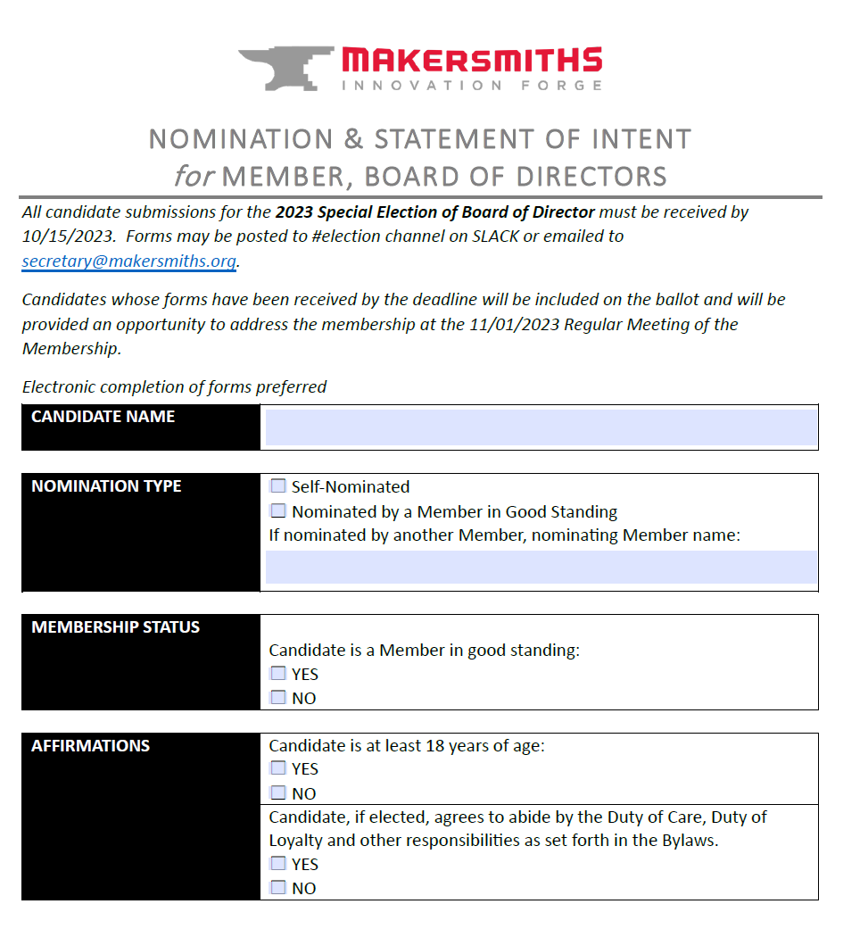
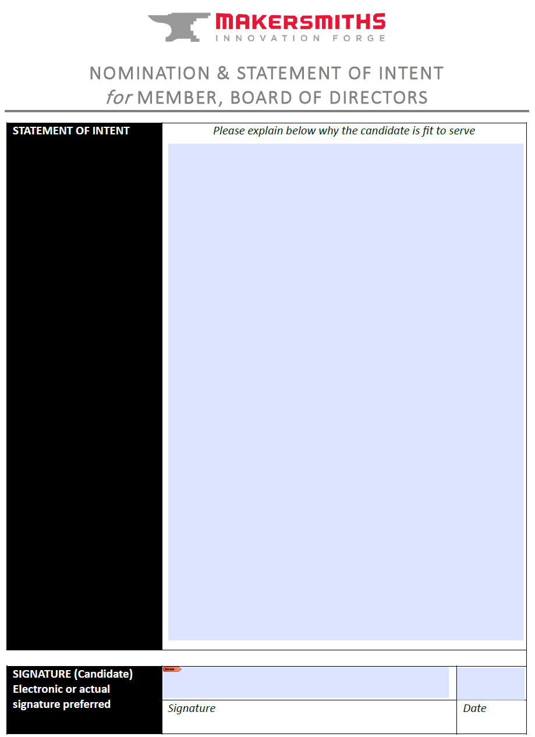
Nomination / Statement of Intent Form

